Slide 1
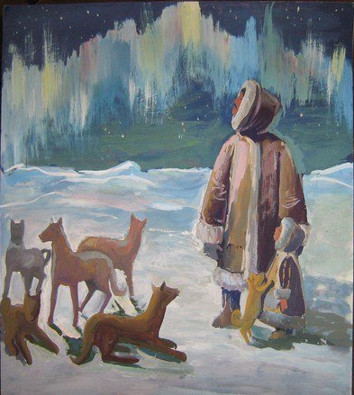
The Role of Subjective Well-being in Stress Development of Arctic Children
Anna K. Fam
  Ph.D, International Laboratory of Positive Psychology of Personality and Motivation, HSE (Moscow)
Anna A. Lebedeva
  Ph.D, International Laboratory of Positive Psychology of Personality and Motivation, HSE (Moscow)
Tatyana A. Fisher
  Ph.D, The Tyumen Centre of Sciences, Siberian Branch of Russian Academy of Sciences (Tyumen)

Slide 2
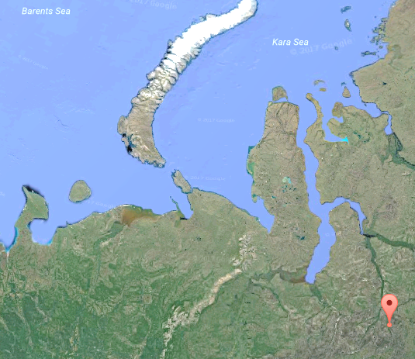
Problem and background
Indigenous Arctic ethnic groups live in special geographical and extremely harsh climate conditions.
Since the Soviet period, the civilization has reached the Extreme North to develop their natural resources.
Most of children have to leave their native settlement and go to boarding schools in towns.
Moving to a boarding school is a challenge for a kid on immune, eco-social, psycho-social, and personality-existential levels.
Problematic adaptation of children and teenagers to modern life conditions leads to alcohol abuse and deviant behavior in this group.
Kharampur
Yamal-Nenets Autonomous District, Tyumen Oblast, Russia

Slide 3
Methodological foundations
Personality is a product of social and cultural development (L.S. Vygotsky, A.N. Leontiev)
Personality belongs to self-regulating dynamic functional systems (activity approach)
All regulating systems of the organism (immune, mental and personality) comply with the cooperativity principle due to the similarity of their functional organization formed in phylogenesis (T.A. Fisher, C.A. Petrov, I.G. Akmaev, etc.)
Stress is a state of tension and mobilization of regulatory systems (H. Selye, K. Goldstein)
Subjective well-being is a feedback phenomenon of personality state in terms of self-regulation approach (D. A. Leontiev, etc.)
Purpose: to observe a role of personality in processes of stress development.

Slide 4
Theoretical basis
Life satisfaction reflects the quality of self-regulation

Slide 5
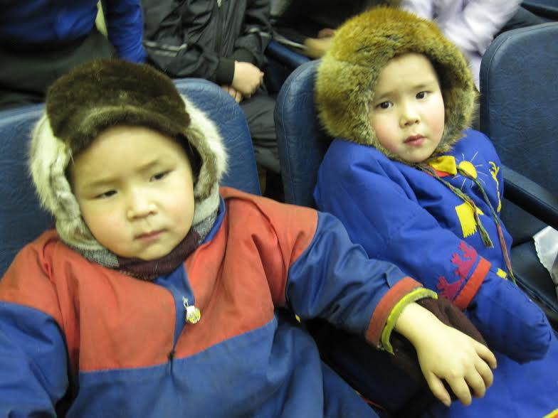
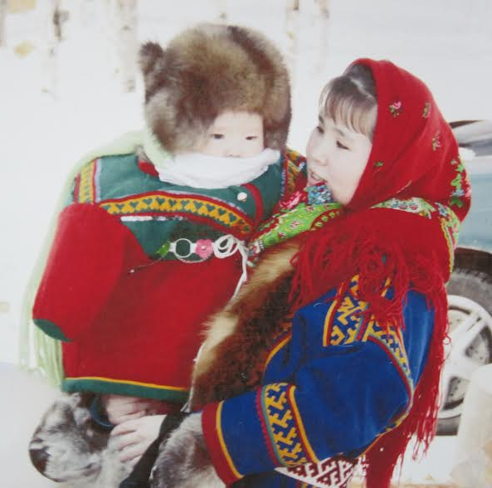
Sample
47 children and teenagers of a boarding school in Kharampur (it is about 60% of the children from this school):
  1st group (school): children who are separated from their parents and live in a boarding school (N=22, age M=12 years, 12 male, 10 female)
  2nd group (village): children who study in the same boarding school but live with their parents in a village (N=25, age M=9,5 years, 16 male, 9 female).
The first idea: stress associated with
being in a boarding school.

Slide 6
Methods
Vegetation level
- Vegetation index test Kerdo, which gives information on balance of irritability of sympathetic and parasympathetic nervous system
Immune level
- Cortizone, serotonin, neuropeptide and also Interferon gamma and Interleukin 4 which are markers of specific immune response that had been developed earlier
Psychic level
- Lüscher color test as an indicator of current psychophysiological intenseness (twice - in the beginning of survey and one in the end to control to emotional condition)
Personality level
- Diener’s Satisfaction With Life Scale as an indicator of subjective well-being

Slide 7
Study design
An experimental situation: a situation of moderate stress (possibly, even of positive one)
An independent variable: the impact to inner world of respondents itself
A dependent variable: stress parameters (fixed by the Lüscher test)
Sample: school + village
The aim: to analyze a role of life conditions in stress development (using Lüscher test parameters)

Slide 8
1. Psychological survey as a contextual stress
Challenges:
the situation of psychological study was absolutely new and unusual for the children. Our study was experimental ex post. We found out traces of psycho-emotional stress in the end of the survey.
Life conditions |  | Balance of personality traits (L1 / L2) | Working capacity (stress) (L1 / L2) | General level of stress (L1 / L2)
School | Z | -1,228 | -,633 | -4,025***
Village | Z | -2,375** | -2,170* | -4,282***
Note: *** p<0,0001, ** p<0,001, * p<0,05. The data was compared by Wilcoxon test.
Initially, we didn’t plan to focus on this parameter in our research,
but we had to review our assumptions and aims.

Slide 9
Results
Two groups: 1st - high satisfaction with life & 2nd - low satisfaction with life.
Satisfaction with life is negatively associated with Lüscher parameters of stress in the end of the survey ONLY in the group with low subjective well-being.
Life conditions | SWLS
Balance of vegetative nervous system | -0,512*
Working capacity | -0,423*
Note: * p<0,05
Also we found that the higher serotonin index the higher vegetative mobilization in the end of the survey.
Life conditions | Serotonin
Vegetative mobilization | 0,437*
Note: * p<0,05
Vegetative stress depends on serotonin and life unsatisfaction
only in the group with low subjective well-being.

Slide 10
2. The role of satisfaction with life in stress development
Hypothesis: satisfaction with life may make a contribution to contextual stress development of children.
In Regression model we checked out an input of such factors as cortisone, serotonin, neuropeptide and satisfaction with life into development of general and contextual stress.
The same regression model was checked for two cases:
which variables predict primary stress condition at the time of the beginning of the survey, and
how the same variables predict the development of stress aroused by the survey.
Both regression models were statistically significant and explained a half of dispersion.

Slide 11
Regression model 1 (in the beginning of the survey)
Variables | R | R Square | Adj.R Square | F | sig | Beta | t | sig
General level of stress (L1)
Serotonin | 0,659 | 0,435 | 0,332 | 4,23 | 0,011 | 0,32 | 2,00 | 0,058
Neuropeptide |  |  |  |  |  | 0,54 | 3,11 | 0,005
Satisfaction with life |  |  |  |  |  | -0,19 | -1,09 | 0,290
Cortizone |  |  |  |  |  | 0,05 | 0,29 | 0,775
The general level of stress in the beginning of the survey is predicted by the neuropeptide index. Serotonin gives an input to primary stress only as inclination.

Slide 12
Regression model 2 (in the end of the survey)
Variables | R | R Square | Adj.R Square | F | sig | Beta | t | sig
General level of stress (L2)
Serotonin | 0,710 | 0,504 | 0,414 | 5,592 | 0,003 | 0,42 | 2,71 | 0,013
Neuropeptide |  |  |  |  |  | 0,10 | 0,63 | 0,535
Satisfaction with life |  |  |  |  |  | -0,55 | -3,32 | 0,003
Cortizone |  |  |  |  |  | 0,39 | 2,46 | 0,022
The general level of stress in the end of the survey is predicted by the serotonin and cortisone indexes and – mostly - by negative index of satisfaction with life.

Slide 13
Conclusion
Unsatisfaction with life contributes to stress development exactly during the stress impact.
Children with low subjective well-being are more open to contextual stress development than those with high well-being scores.
High satisfaction with life suppresses contextual stress development.
Satisfaction with life is a personality resource which acts as a protection from outer stress-inducing impacts.

Slide 14
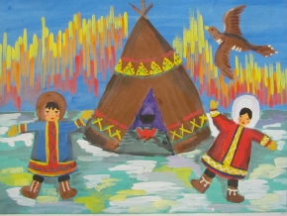
Thank you for your attention!

